Slide 1
Group Life Insurance Benefits Orientation
For the Employees of: FPT SOFTWARE PHILIPPINES CORP.
Policy Effective Date: April 01, 2026

Slide 2



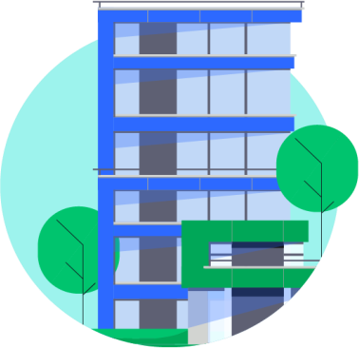
Manulife in the Philippines…
Established
Wholly-owned subsidiary of
Manulife based in Toronto,
Canada
With a dynamic management team composed of financial services experts
1907

Slide 3





Group Life Insurance Benefits
Basic Life
(BL)
Accidental Death, Dismemberment & Disablement Benefit
(ADD&D)
Total Permanent Disability Benefit
(TPDB)
Terminal Illness Benefit
(TIB)
Family Assistance Benefit (FAB)

Slide 4


Who are Eligible?
Group Life Insurance Benefit
All active, regular and full-time employees who are at least 18 to 65 years of age and are in good health at the inception of the policy.
Future full-time employees shall be enrolled upon
eligibility.
Probationary Employee will be covered under NEL upon confirming that they undergo and passed medical exam prior to employment; otherwise their coverage is subject for First Peso Underwriting.

Slide 5
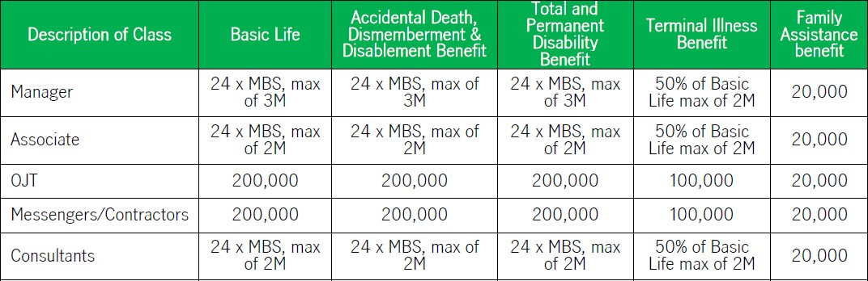
Group Life Insurance Benefit
Schedule of Coverage for ALL the Eligible Employees

Slide 6

ACCIDENTAL DEATH, DISMEMBERMENT, & DISABLEMENT BENEFIT (ADD&D)
GROUP LIFE INSURANCE
Should an insured employee suffer a loss, or any bodily injury (directly and independently of all other causes), affected solely through external, violent and accidental means, within one hundred eighty (180) days from the said accident, Manulife will pay the employee, if living, otherwise, his/her designated beneficiary/ies, an amount equal to the benefit specified in the policy.

Slide 7

ACCIDENTAL DEATH, DISMEMBERMENT, & DISABLEMENT BENEFIT (ADD&D)
GROUP LIFE INSURANCE
LOSS | %
Life | 100%
Two hands | 100%
Two feet | 100%
Sight of two eyes | 100%
One hand and one foot | 100%
One hand and sight of one eye | 100%
One foot and sight of one eye | 100%
Hearing of Both ears | 100%
Speech | 100%
Whole Arm | 60%
Lower Arm | 50%
One hand or One foot | 50%
Sight of one eye | 50%
LOSS | %
Hearing of one ear | 50%
Whole leg | 50%
Lower Leg | 40%
All four fingers and thumb of either hand | 40%
Thumb | 20%
Fingers of one hand index finger middle finger ring finger little finger | 10% 5% 3% 2%
Toes of one foot all big toe any toe other than big, each | 10% 5% 1%
Sample Scenario & Computation:
An insured member got involved into an accident resulting to loss of his left hand.
ADD&D Benefit = 1,000,000
Total Claim = 500,000
Loss of One Hand = 50%

Slide 8
ACCIDENTAL DEATH, DISMEMBERMENT, & DISABLEMENT BENEFIT (ADD&D)
GROUP LIFE INSURANCE
Accidental Dismemberment
Loss of hands and feet shall mean dismemberment by severance at or above the wrist or ankle joints respectively while loss of eyesight should be total and irrecoverable.
*In case of multiple injuries from one accident, only the loss carrying the highest indemnity will be considered payable.

Slide 9
ACCIDENTAL DEATH, DISMEMBERMENT, & DISABLEMENT BENEFIT (ADD&D)
GROUP LIFE INSURANCE
EXCLUSIONS on Accidental Death, Dismemberment & Disablement Benefit (ADD&D).
No benefit shall be made for any loss resulting from or caused by any of the following:
Suicide or intentionally self-inflicted injury or any similar attempt whether sane or insane
Any kind of disease, sickness or infection other than bacterial infections occurring as a consequence of an accidental cut or wound
Insect Bite
War or any act incident to war, whether declared or undeclared
Insanity
Riot, civil commotion or insurrection
Pregnancy, childbirth, miscarriage or abortion
Travel or flight in or descent from any aircraft, if the insured person is a member of the crew or pilot of the aircraft, or if the flight is made for instructional or training purposes
Congenital anomalies or conditions arising from there
Any violation or attempt of violation of the law or resistance to arrest
Any drug, poison, gas or fumes voluntarily or otherwise taken, administered, absorbed or inhaled, other than as a result of an accident arising from a hazard incident to the member’s occupation
Murder or provoked assault
Any loss in which the proximate cause was the member’s attempt at, or commission of or willful participation in any act or crime punishable under the Revised Penal Code of the Philippines or any other statute except crimes of reckless imprudence as defined in Article 365, or similar laws of any country in which the crime was attempted or committed, or resistance to lawful arrest
Nuclear weapons or fissionable material, ionizing radiation or contamination by radioactivity from any nuclear fuel or from any nuclear waste, or from the combustion of nuclear fuel, and for the purpose of this exclusion, combustion shall include any self- sustaining process of nuclear fission or fusion

Slide 10
ACCIDENTAL DEATH, DISMEMBERMENT, & DISABLEMENT BENEFIT (ADD&D)
GROUP LIFE INSURANCE
Double Indemnity
Manulife will double any indemnity if the member suffers the death by any of these cases:
While riding as a passenger within any motorized & duly licensed public utility land transport. (ex. Jeepney, Bus, Taxi)
While riding in an elevator car (mines & construction sites excluded)
In consequence of the burning of any theater, hotel, mall, church, market, restaurant or other public building in which the presence of the member is only coincidental

Slide 11
ACCIDENTAL DEATH, DISMEMBERMENT, & DISABLEMENT BENEFIT (ADD&D)
GROUP LIFE INSURANCE
Double Indemnity Sample Computation
Scenario:
An insured member went to the mall for shopping when the building collapses due to fire resulting to his death.
The beneficiaries of the insured member will receive the benefit based on this computation:
500,000 | + | 500,000 | + | 500,000
ADD&D Benefit |  | Double Indemnity |  | Basic Life Benefit
 |  | Benefit
=
1,500,000
Total Benefit
Claim

Slide 12
TOTAL & PERMANENT DISABILITY BENEFIT (TPDB)
GROUP LIFE INSURANCE
Should an insured employee become totally and permanently disabled for a period of at least six (6) consecutive months resulting from any bodily injury or disease and is prevented from engaging in any and every occupation, profession or business, for compensation or profit, and will be so disabled for life, Manulife will pay the insured employee in lumpsum amount equivalent to the Death Benefit, to compensate for the employee’s lost income.

Slide 13
TOTAL & PERMANENT DISABILITY BENEFIT (TPDB)
GROUP LIFE INSURANCE
EXCLUSIONS on Total and Permanent Disability Benefit (TPDB).
No benefit shall be made for any loss resulting from or caused by any of the following:
Any injury intentionally self-inflicted
War or any act incident to war whether declared or undeclared
Riot, civil commotion or insurrection
Travel or flight or descent from any aircraft as a member of the crew, or
Attempted murder
Travel or flight in or descent from any aircraft of any military, naval, or air force
Any violation or attempt of violation of the law or resistance to arrest
Provoked assault, or participation in an assault or brawl
Any drug, poison, gas or fumes, voluntarily or involuntarily taken, administered, absorbed or inhaled, except as a result of an accident arising from a hazard incident to the member’s occupation.

Slide 14
TERMINAL ILLNESS BENEFIT (TIB)
GROUP LIFE INSURANCE
This benefit, which is equivalent to 50% of the basic life coverage, shall be paid in advance if the member is diagnosed of any terminal illness* (up to a maximum of P2,000,000). The balance of the total basic life coverage will be paid to the designated beneficiary/ies of the insured employee.
*Terminal Illness is defined as the occurrence of a severe Illness that will lead to the death of the insured within 12 months.

Slide 15

FAMILY ASSISTANCE BENEFIT (FAB)
GROUP LIFE INSURANCE
Upon receipt of due proof of the death of an insured employee under the Policy, Manulife shall pay the amount of Family Assistance Benefit applicable and as indicated in the Policy. This benefit helps cover expenses or settle outstanding debts brought about by the death of the employee.
The benefit under this Rider shall be payable to the same beneficiary who is entitled to receive the member’s Life Insurance benefit, in accordance with the Policy provisions.

Slide 16



BENEFICIARY

Slide 17



BENEFICIARY DESIGNATION
GROUP LIFE INSURANCE
We encourage all eligible employees to follow the Hierarchy
below in designating the beneficiaries:
If Insured is Single
If Insured is Single with a Child
If Insured is Married
Child is the legal heir.
(subject to submission of proof and other requirements).
Spouse is the legal heir.
(require Original PSA Marriage Contract & other requirements)
Parents are the legal heirs.

Slide 18
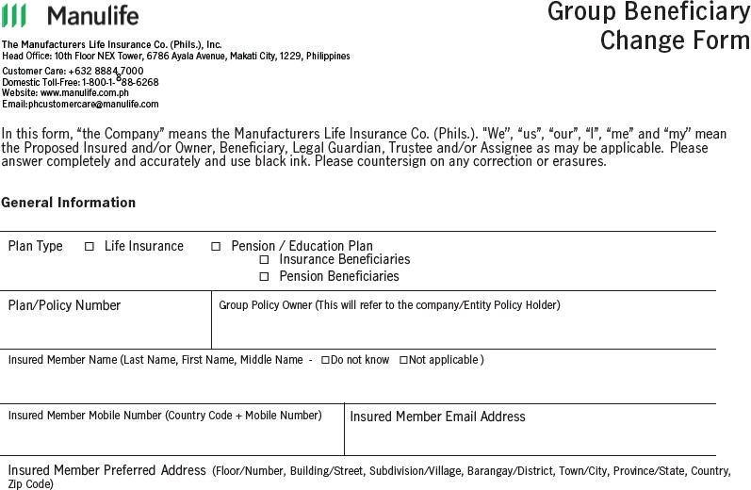
BENEFICIARY DESIGNATION FORM
GROUP LIFE INSURANCE

Slide 19
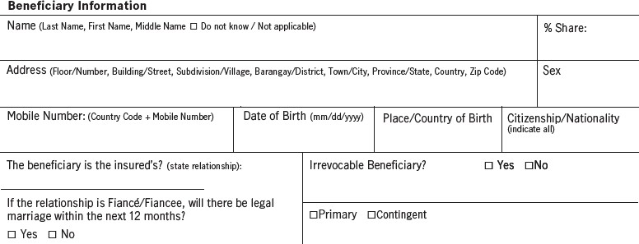
BENEFICIARY DESIGNATION FORM
GROUP LIFE INSURANCE
An insured employee may opt to allocate certain percentage of the proceeds for each of the designated beneficiaries by writing the no. of shares in this portion.

Slide 20
BENEFICIARY DESIGNATION
GROUP LIFE INSURANCE
If the designated beneficiary is a minor, a trustee must be appointed by the insured. If none was appointed, then the guardian will have to be appointed or approved by the court.
In case of a claim the Claimant’s Statement must be accomplished by the appointed trustee or by the court approved guardian and submit any of the applicable legal documents:
1. Duly Notarized Affidavit of Parental Care & Custody. This is to be executed by the minor’s father or in his
absence, the mother, if the share of the minor does not exceed Php500,000.00.
2. Duly Notarized Affidavit of Substitute Parental Care & Authority. This is to be executed by the appointed
trustee other than the natural parents if the share of the minor does not exceed Php500,000.00.
3. Letters of Guardianship shall be required if the minor is orphaned on both parents.
4. Approved Verified Petition for Guardian’s Bond if the appointed trustee is any or both the natural parents if
the share of the minor exceeds Php500,000.00.
5. Trusteeship Bond if the appointed trustee is other than the natural parents if the share of the minor beneficiary exceeds Php500,000.00.

Slide 21
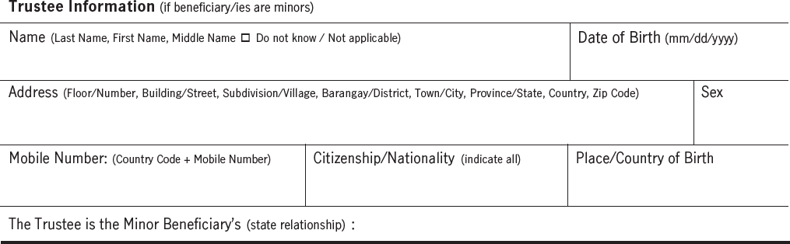
BENEFICIARY DESIGNATION FORM
GROUP LIFE INSURANCE

Slide 22
BENEFICIARY DESIGNATION
GROUP LIFE INSURANCE
Common Law Partner or Same Sex Partner can be designated as a beneficiary provided that they are able to submit the ff requirements:
Common Law Partner: Same Sex Partner:
Cenomar for both partners 1. Cenomar for both partners
Affidavit of Joint Domestic Partnership 2. Interview by a Manulife Advisor
Valid ID’s of both partners 3. Valid ID’s of both partners

Slide 23

CLAIMS REQUIREMENTS

Slide 24
CLAIMS PROCESS
Group Life Insurance Benefit
Customer/Agent
Send an email to PH Claims
PH Claims
Screen and endorse for processing
Claims Team
Review and Process claim
PH Claims
Notify customer/agent of completion
Send acknowledgement within 24 to 48 hours
Ask for additional requirements (if any)
Screen for completion and endorse to processing team for review
Send claim notification
Send requirement (please refer to separate checklist)
Review, approve, and process claim application
Directly credit proceeds to bank account
Notify customer and agent via email that proceeds was already credited to bank account
Dedicated email for Group and Individual Claims:
phclaims@manulife.com
- All submissions, inquiries, and status updates can be emailed to this address

Slide 25
Group Life Insurance Benefit
DEATH CLAIMS REQUIREMENTS (BL/FAB)
GROUP LIFE INSURANCE
Claimant’s Statement
Physician’s Statement
Original or Certified true copy of Death Certificate
4
Original or Certified true copy of Birth/Baptismal Certificate of the insured
5
PSA Original copy of Marriage contract (if the beneficiary is the spouse)
6
Photocopy of two (2) claimant’s valid/government issued ID
7 Employer’s Statement
Note: Additional documents may be required in view of certain information revealed during the review of the claim.

Slide 26
ADD&D BENEFIT CLAIMS REQUIREMENTS
GROUP LIFE INSURANCE
Accident Claim Form
Attending Physician’s Statement
Statement from Identifying Witness, if applicable
4
Police or NBI Report, if applicable
5
Medical Abstract / Admitting History, if applicable
6
Operation Room Record, if applicable
Note:
Additional documents will be required in view of certain information revealed during the review of the claim. The release of the forms does not mean that the insurance coverage is in force with respect to the employee and that there is a valid claim under the group policy.

Slide 27
TPD BENEFIT CLAIMS REQUIREMENTS
GROUP LIFE INSURANCE
Proof of Disability (Claimant’s Statement)
Proof of Disability (Attending Physician’s Statement)
3
Birth Certificate (Certified True Copy ) or Any Proof of Age (Baptismal Certificate or Marriage Contract)
4
Insurance Claim Verification Form (to be completed by Claims Dept.)
5
Certified true Copy of Daily Time record
6
Claimant may be requested to be examined by an accredited physician of Manulife
Note:
additional documents may be required in view of certain information revealed during the review of the claim
Certified True Copies of documents should be submitted

Slide 28
TERMINAL ILLNESS BENEFIT CLAIMS REQUIREMENTS
GROUP LIFE INSURANCE
Terminal Illness Form
Employer Statement Form
Medical Records
4
Photocopy of two valid government-issued ID
Note:
Additional documents may be required in view of certain information revealed during the review of the claim.

Slide 29
Group Life Insurance Benefit
Manulife website
www.manulife.com.ph

Slide 30

QUESTIONS about
GROUP LIFE INSURANCE BENEFITS?
Group Life Insurance Benefit

